Slide 1



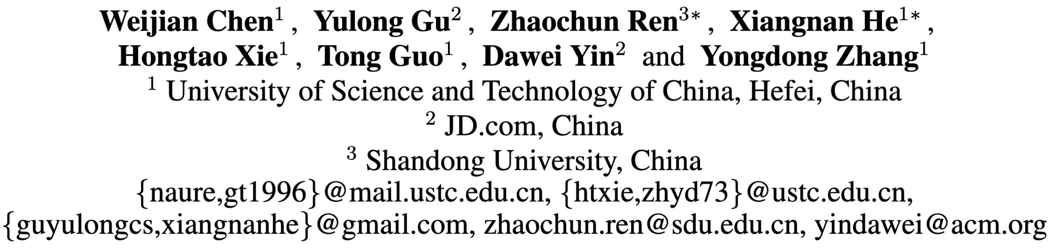

Semi-supervised User Profiling with Heterogeneous Graph Attention Networks

Slide 2
Contents
Motivation
Problems
Methods
Experiments
Conclusion
Notes:
I split the contents into five parts, which consist of ……

Slide 3
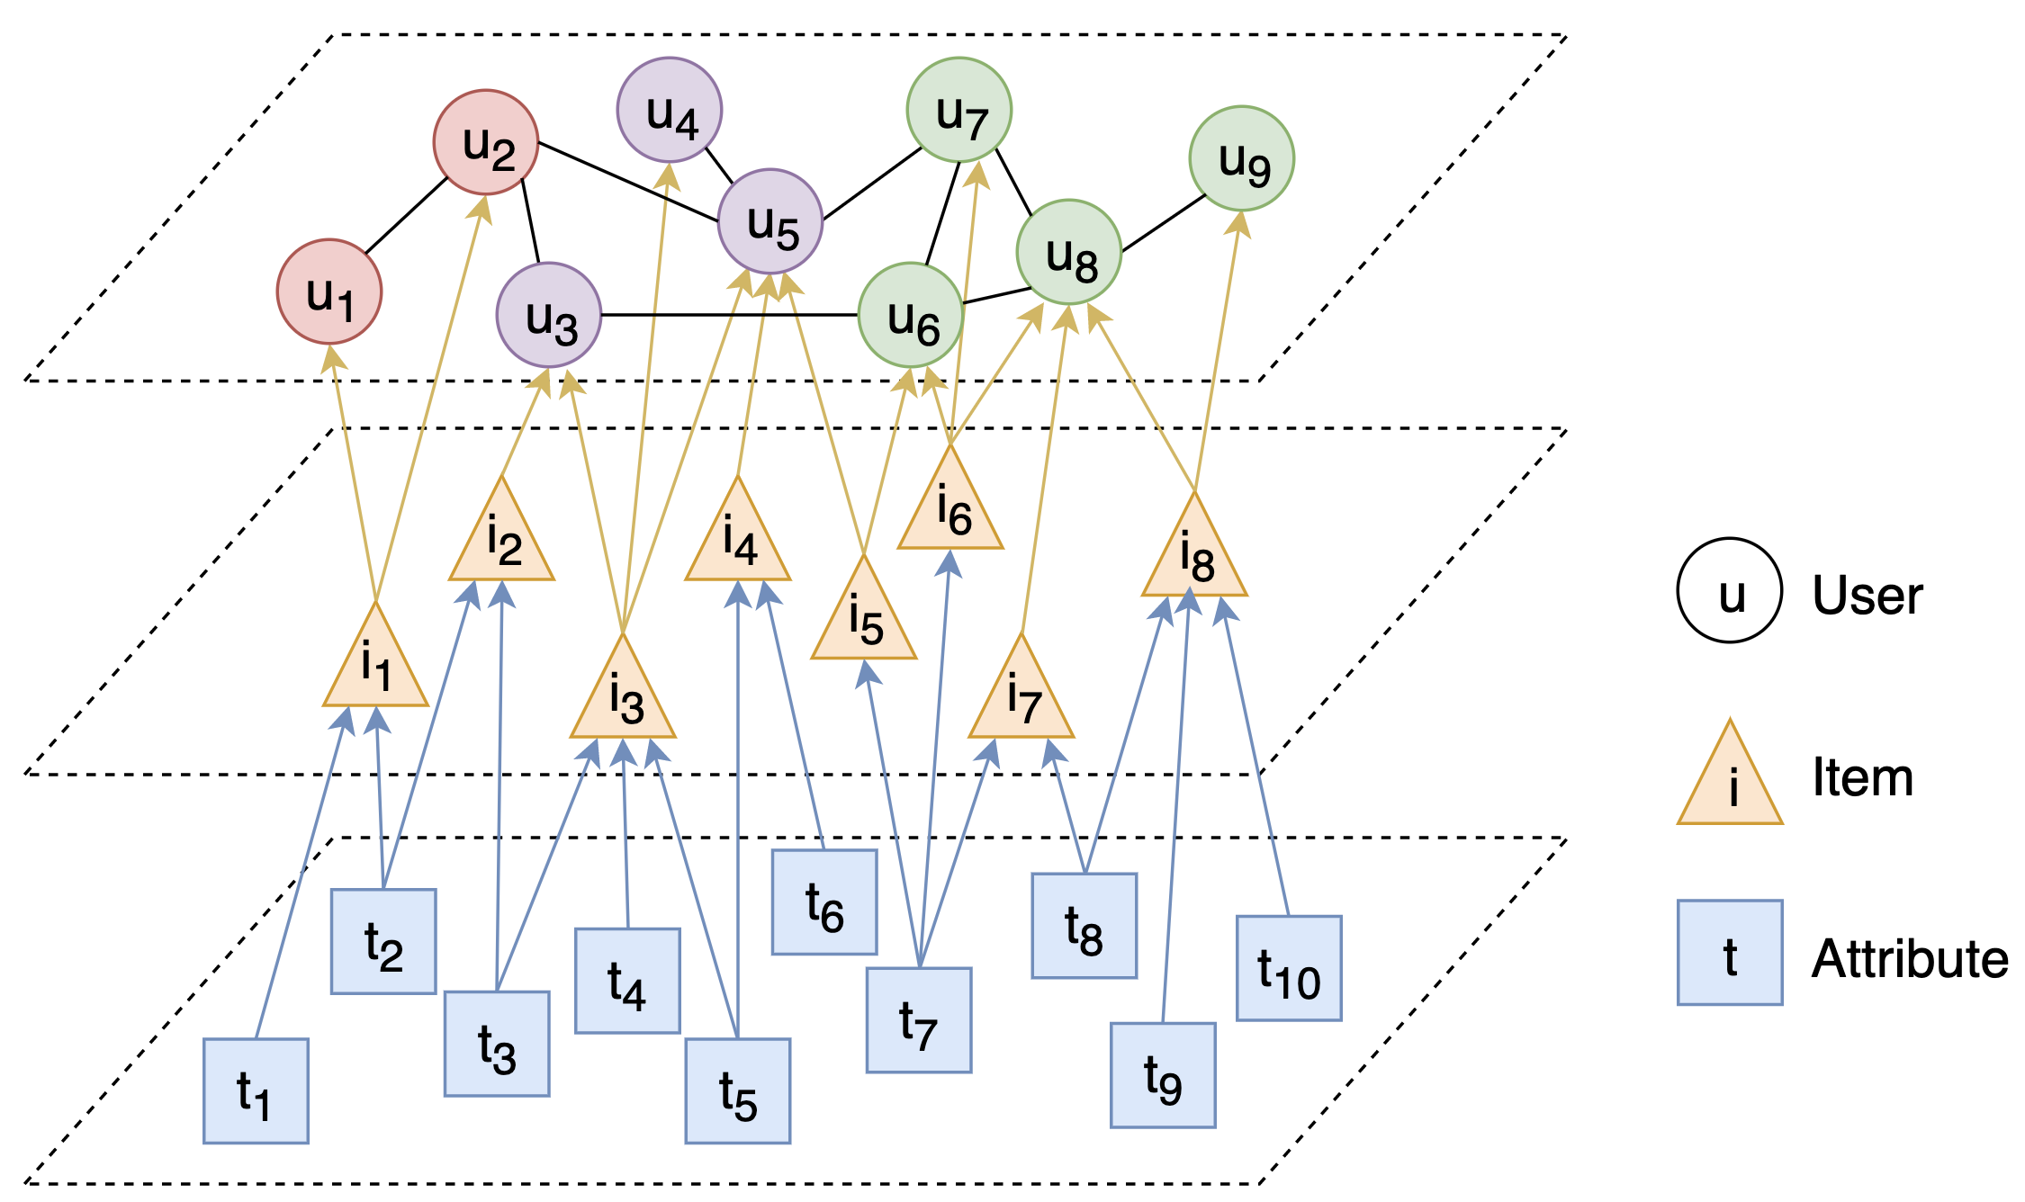
Motivation
Existing user profiling methods suffer from two common issues:
Only one type of information is used to infer user’s profile, whereas other types of data cannot be naturally integrated.
Only self-generated data is exploited to learn the user profiling representation, whereas the rich interactions among data instances are neglected.
User Profiling in the heterogeneous graph
The heterogeneous information should be considered in user profiling!
Notes:
Now let’s start from the first part, motivation.
We can illustrate these two problems with the help of the picture on the right.
(The figure is an example of heterogeneous graph in user profiling task, which consists of there types of nodes, users, items and attributes.
The highest in the figure is user nodes, the middle is item nodes user interacted with, and the bottom is the item’s attribute.
Here the different categories of users are assigned different colors.)
Most of the existing work USES only the user nodes and their interactions, that is, just the information at the top of the diagram.
And they neglect the interaction information among different types of nodes, which is important in user profiling.
We can explain these by user 3, user 4 and user 5. They have the same labels, but don’t connect with each other, so we can’t infer they have the same label from the interaction between them.
However, they all connect with item 3, which is their similarity that can help we know that they have similar label.
Now, we can come to a conclusion：he heterogeneous information should be considered in user profiling！

Slide 4
Problems
For the representation learning in a heterogeneous graph, there exist three critical problems:
How embeddings of nodes are updated?
→ Heterogeneous Graph Attention Operations
How the information is propagated in the graph?
→ Meta-path aware Graph Propagation
3. How to train a model on the big graph?
→ Mini Heterogeneous Graph Sampling
User Profiling in the heterogeneous graph
Notes:
Now we need to tackle with user profiling task in heterogeneous graph, so we will face three problems:
2. That is how can we spread information from attribute, by the way of item, and to user ultimately.

Slide 5
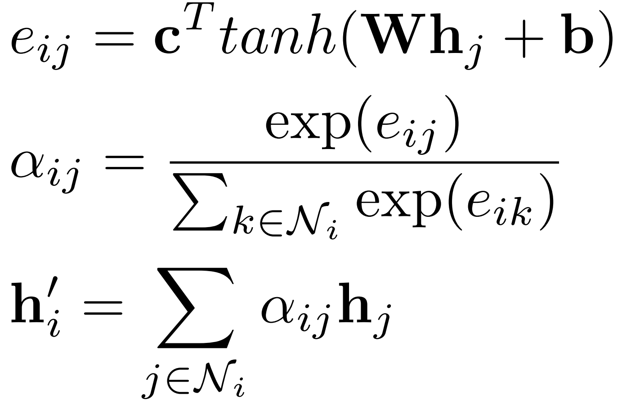

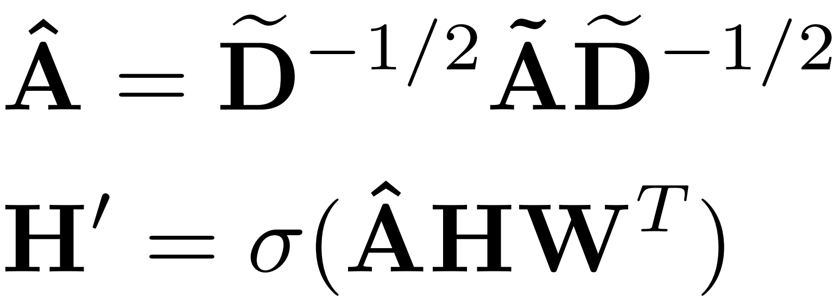
Methods
Heterogeneous Graph Attention Operations
Vanilla Attention Operation
Graph Convolutional Operation
context vector
adjacency matrix
identity matrix
degree matrix
Notes:
In the operation, the context vector c, the weight matrix W and the bias vector are used to calculate the attention score, which measures the importance of a neighborhood node j to the
node i.

Slide 6
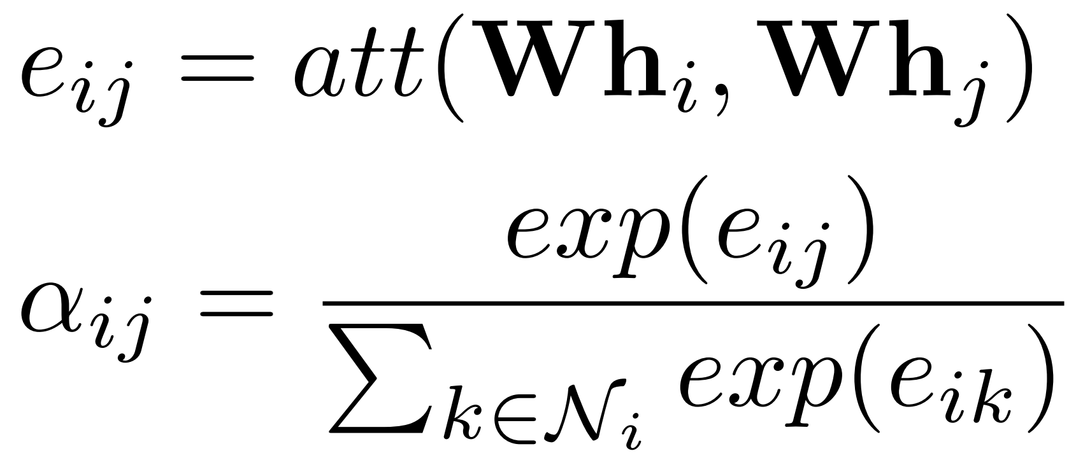
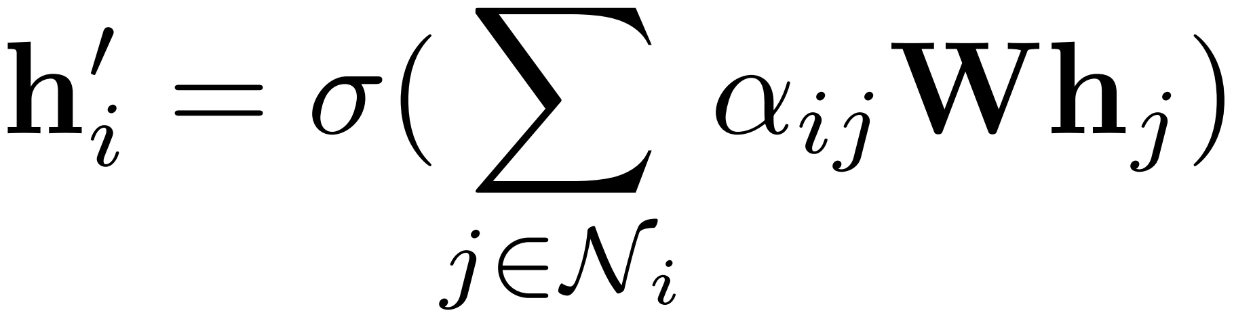
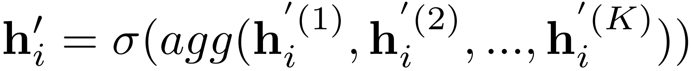
Methods
Heterogeneous Graph Attention Operations
Graph Attention Operation
computes the attention scores
update the embedding of node i
apply K-head attention to increase the representation power
Notes:
Firstly, it computes the attention scores between nodes based on a shared attentional mechanism.
To make coefficients easily comparable across different nodes, the softmax function is used to normalize the attention coefficient e_ij into the attention score
The aggregation function agg can be concatenation or averaging. Specially, if we perform multi-head attention on the final layer, we employ averaging. Otherwise, we apply the
concatenation operation.

Slide 7
Methods
Meta-path aware Graph Propagation
Attribute-Item subgraph.
consists of attributes, items and their interactions.
Item-User subgraph.
consists of items, users and their interactions.
User-User subgraph.
consists of users and edges between them..
Attribute-Item layer.
Vanilla Attention Operation
Item-User layer.
Vanilla Attention Operation
User-User layer.
Graph Convolutional Operation/
Graph Attention Operation

Slide 8
Methods
Mini Heterogeneous Graph Sampling
User-User mini graph.
Sample Lu1 users from the user’s neighbors and denote them as us1;
For each user in us1, we sample Lu2 users from the user’s neighbors;
Iteratively perform these operations k times to obtain k-hop neighborhood.
Item-User mini graph.
For each user in the k-hop mini graph, we sample Li items that the user has interacted with.
Attribute-Item mini graph.
For each item in the Item-User mini graph, we sample Lt attributes to describe the item.

Slide 9
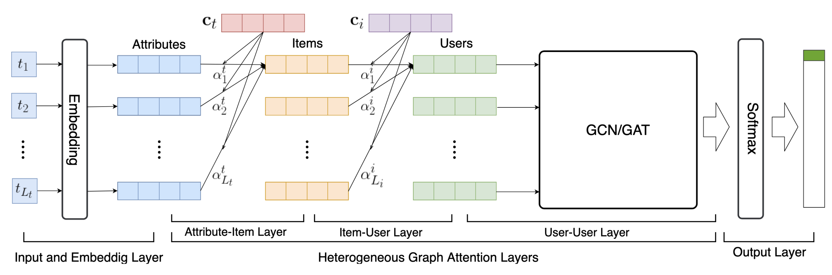
Methods
Loss Function: Cross Entropy
Overall Framework
Vanilla Attention Operation
Graph Convolutional/Attention Operation
Notes:
For the embeddings of attributes, we use FastText [Bojanowski et al., 2017] to learn the embeddings of the words using the whole item titles corpus.

Slide 10
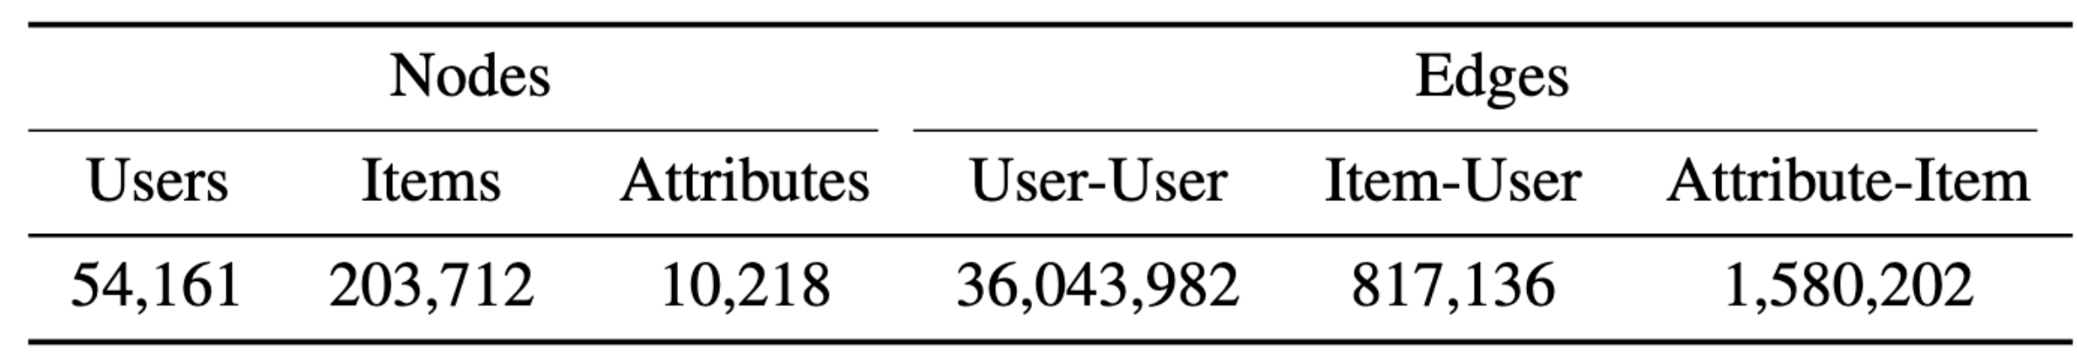
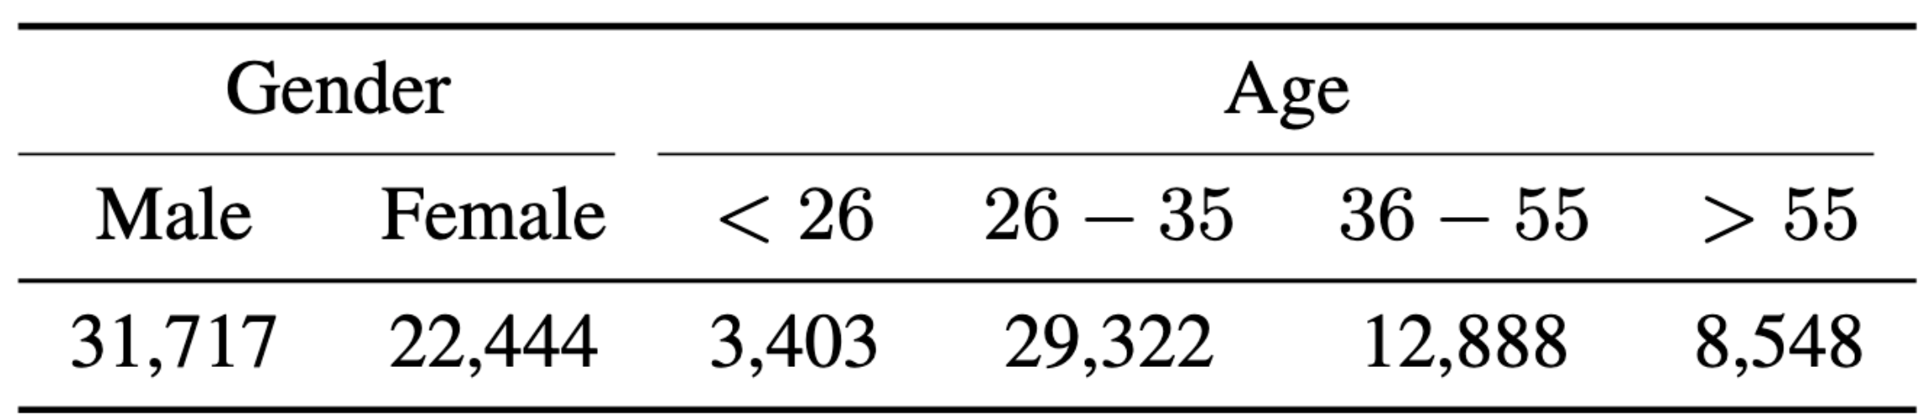
Experiments
Dataset
Statistics of nodes and edges in collected JD dataset
Statistics of each label in collected JD dataset
Notes:
268091, 268 thousands
38,441,320, 38 millions

Slide 11
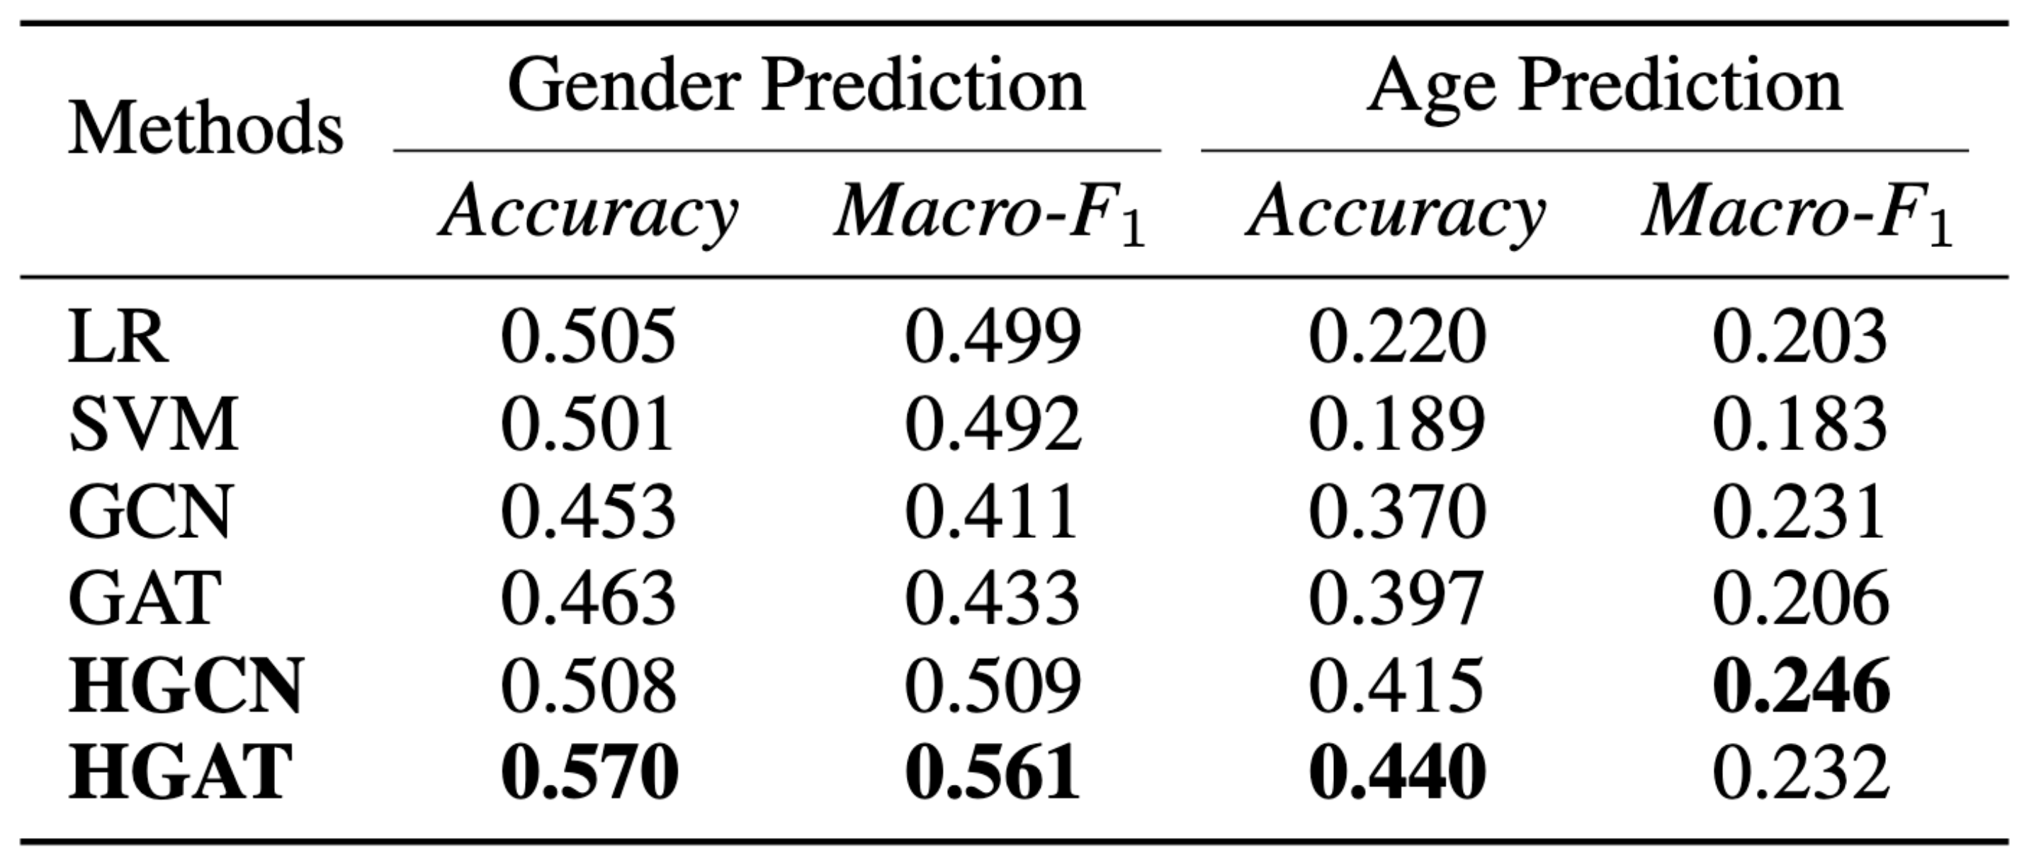
Experiments
Results
From this table, we can find that:
For gender prediction, HGAT achieves the best results in both Accuracy and Macro-F₁.
For age prediction, HGAT achieves the best results in the metric of Accuracy and HGCN achieves the best results in the metric of Macro-F₁.
HGAT and HGCN both achieve impressive improvements than state-of-the-art methods like GCN and GAT, which proves the superiority of our framework.

Slide 12
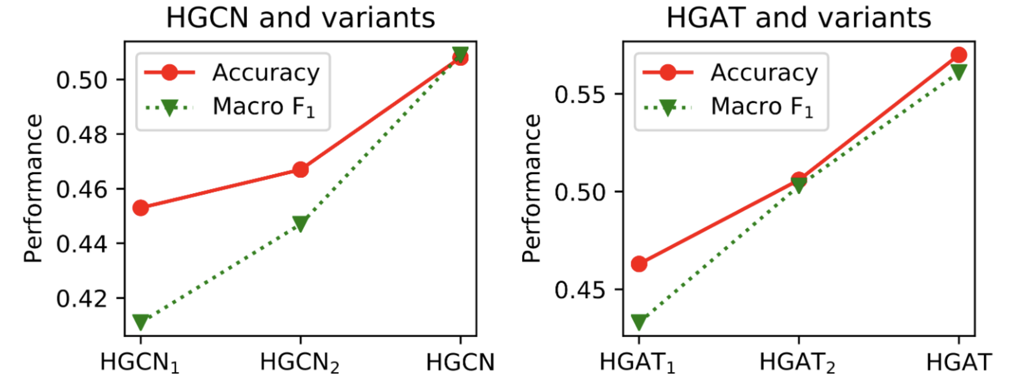
Experiments
Ablation Study
From the experiment results in this figure, we can find that:
The prediction performance is improved when we add the Attribute-Item Layer and Item-User Layer, which exploit attention operations to automatically learn embeddings of items and users based on information in their neighborhoods.
The information propagation operations between heterogeneous nodes are effective for user profiling in the heterogeneous graph.
Our framework can effectively integrate the heterogeneous data in the network and achieve appealing performance for user profiling.

Slide 13
Conclusion
In this paper, we have addressed the task of user profiling in a semi-supervised manner, which aims to solve two challenges in user profiling: single type of input data and negligence of semi-supervised signals.
Our framework heterogeneous graph attention network (HGAT) can automatically model multi-relation graph structure and node features in heterogeneous networks for user profiling, without the need of designing hand-crafted features or fusion method.
Experiments show that HGAT outperforms state-of-the-art baselines and verify the effectiveness of components in HGAT.
Thus, HGAT is capable to leverage both unsupervised information and limited labels of user to construct the predictor.

Slide 14
Data Science Lab @ JD.com
Job Positions: Research Scientists and Interns
If you are passionate about Recommender Systems, Information Retrieval,
Deep Learning, Reinforcement Learning, Graph Neural Networks, NLP, CV and DM,
welcome to join us!!
Contact: guyulongcs@gmail.com
https://datascience.jd.com/
AoYunCun, Chaoyang Qu, North Star Century Center, Beijing, China

Slide 15
Thanks for your listening!

